Slide 1

SPOTIFY ANALYSIS

Slide 2
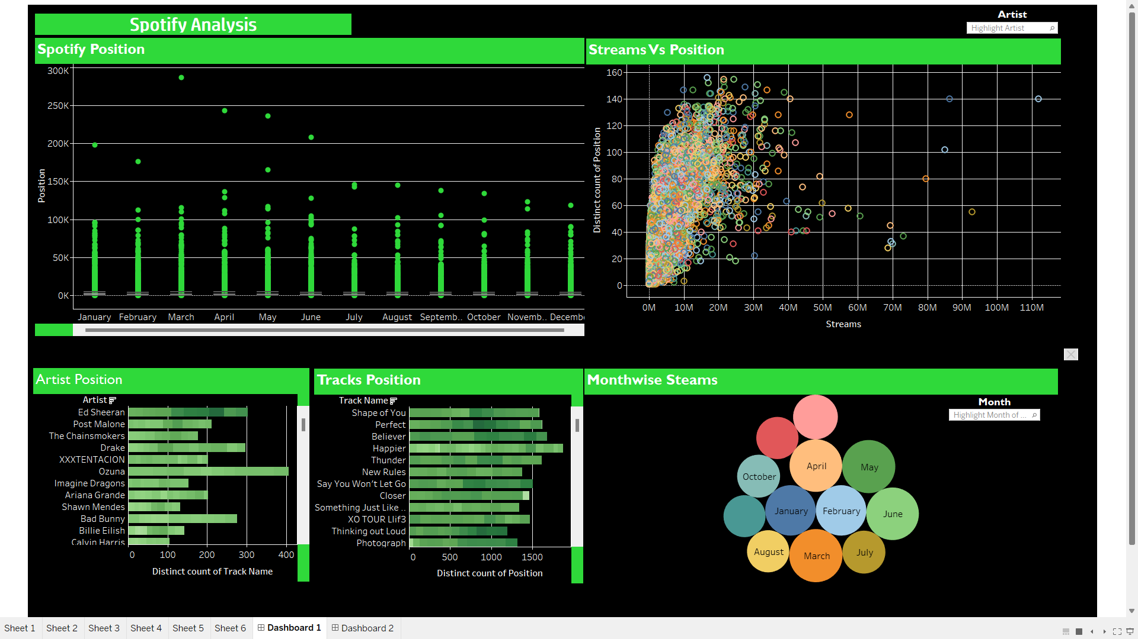
DASHBOARD 1

Slide 3
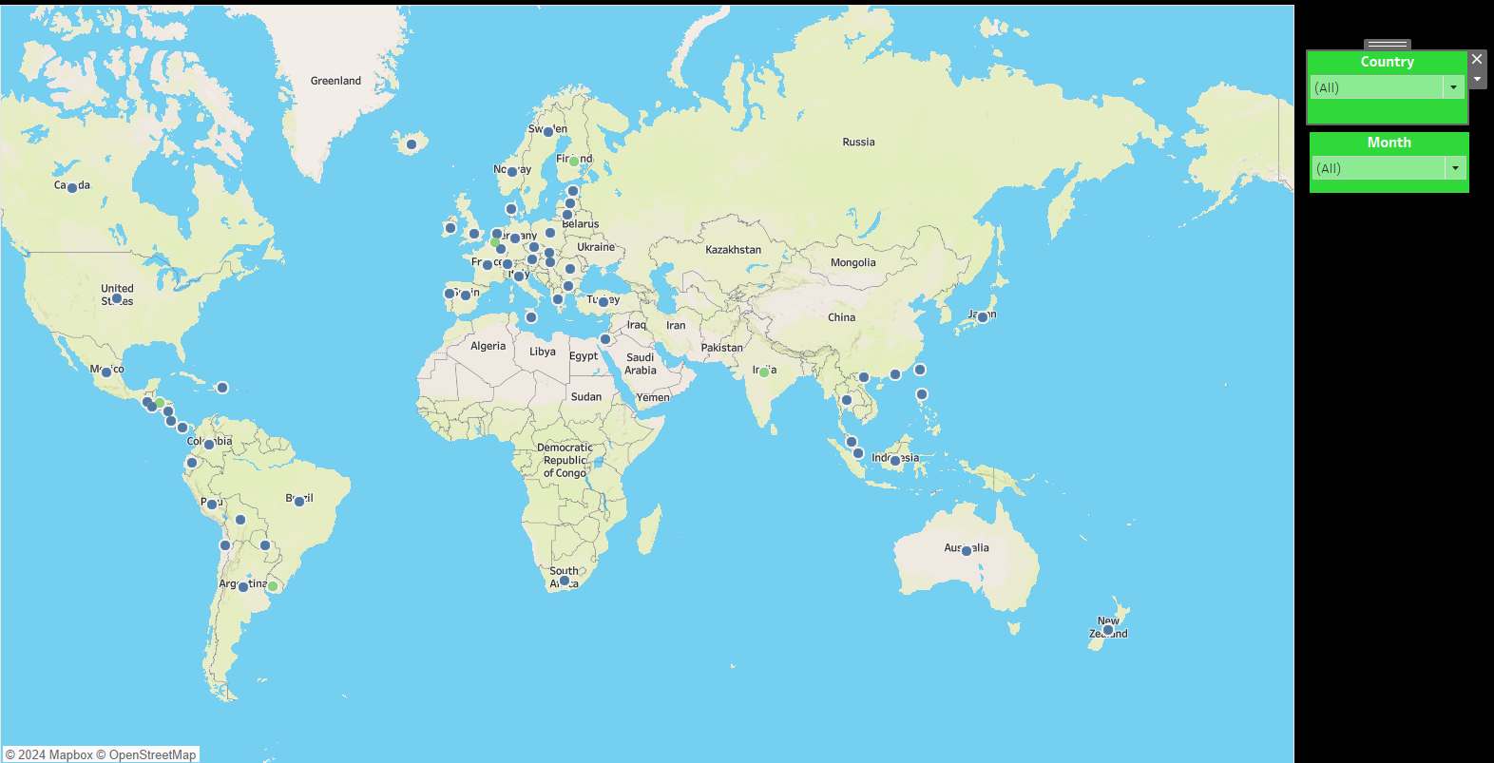
DASHBOARD 2

Slide 4
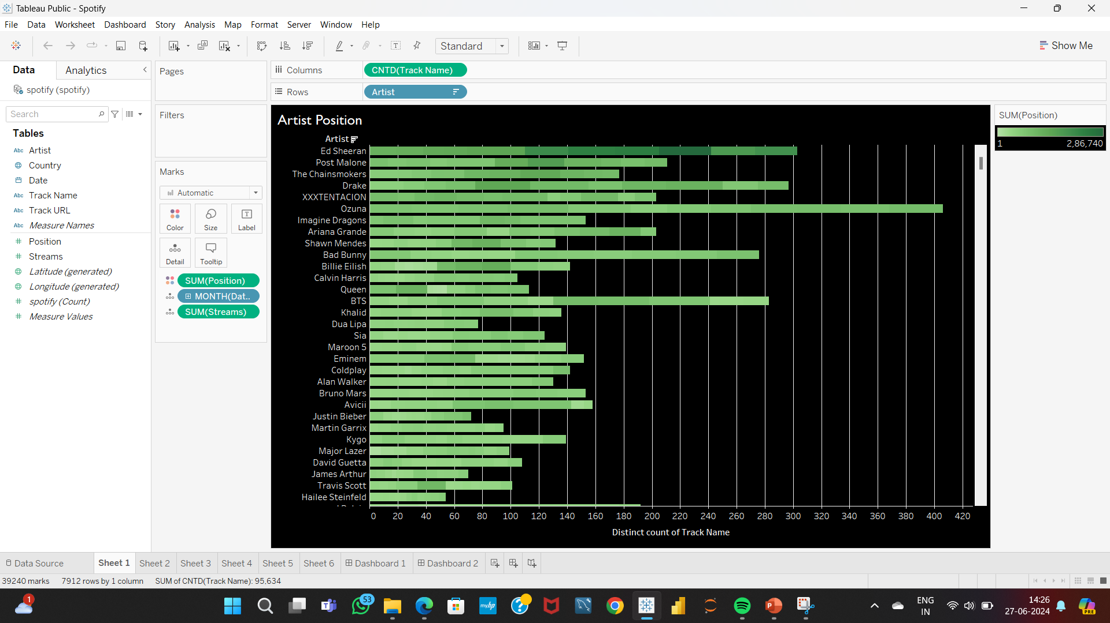
The bar chart visual shows the position of the artists and the count of their tracks.
It has been separated according to the month and the tooltip information's are included for more details.

Slide 5
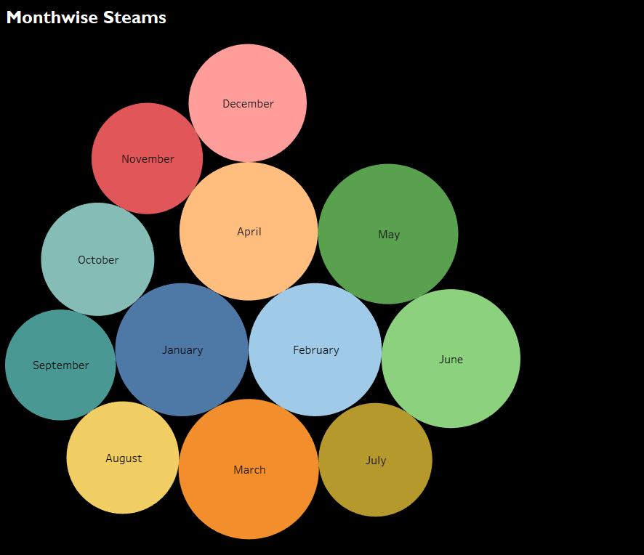
The packed bubbles chart shoes the overall number of streams in the particular month which has several tooltip details.

Slide 6
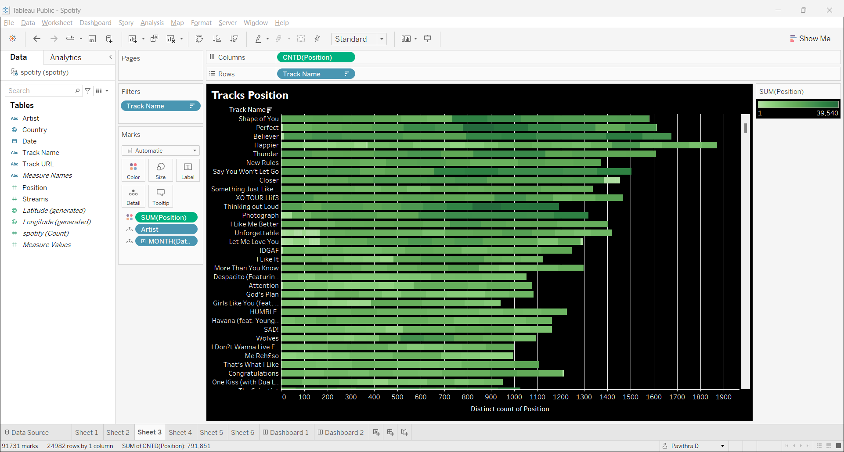
The bar chart visual shows the position of every track relative to the streams
This visual includes more details regarding the month, artists and the position
Tooltip information's also included in the visual.

Slide 7
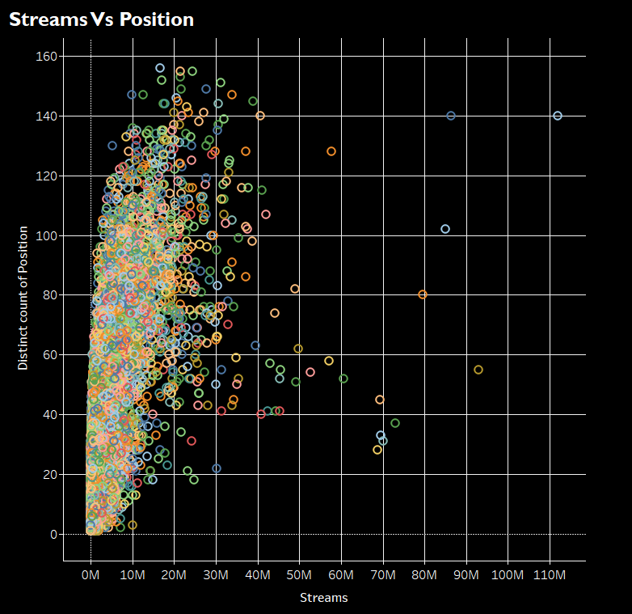
The scatter plot visual show the Streams Vs Position according to each month.
Information like artists, track name, no of streams and positions are included as a tooltip details.

Slide 8
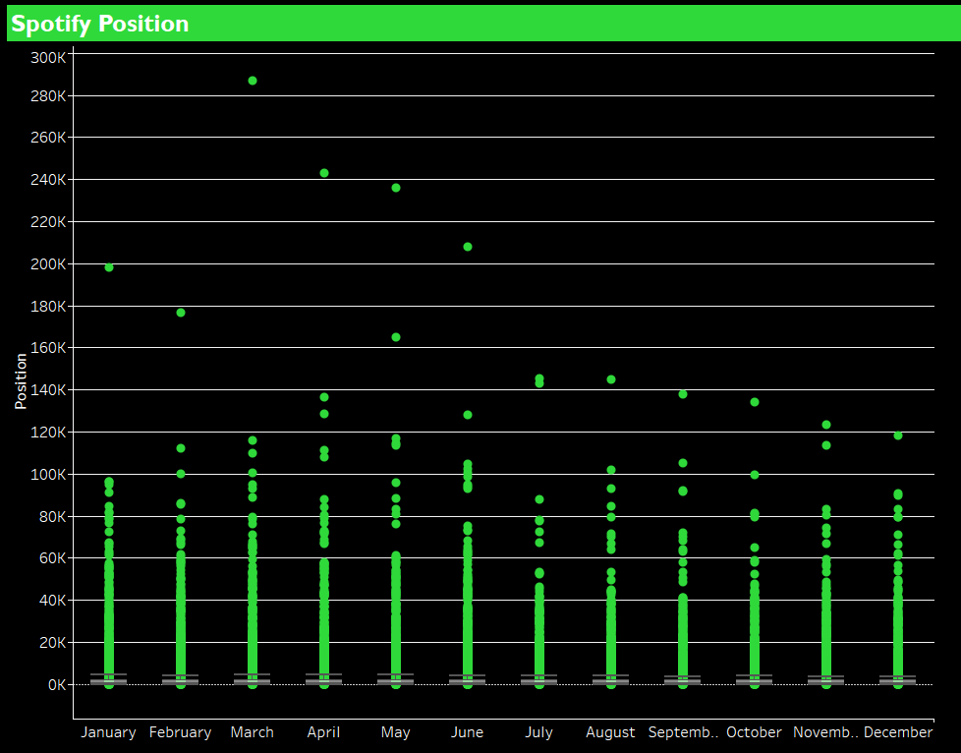
This lines visuals shows the Spotify position of the tracks according to each month.
Several other details are included in the dashboard visuals.

Slide 9
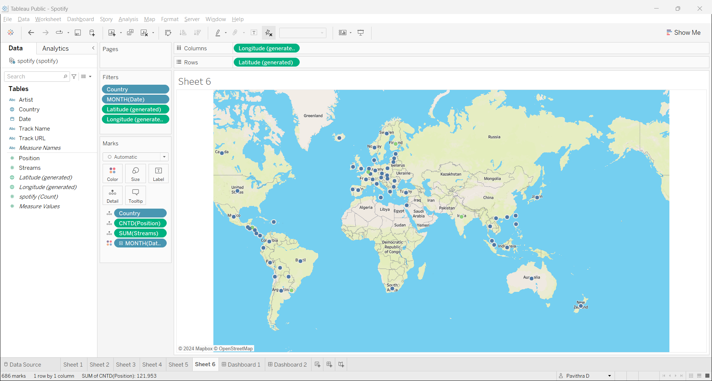
The map visual shows the streams and positions of the tracks across several countries according to the month.

Slide 10
Key Performance Indicators(KPIs)
Reach and Impressions: Measure how many people your ad reached and how often it was displayed. These metrics help evaluate brand visibility
Conversions: Track actions taken by listeners after hearing your ad. This could include website visits, app downloads, or purchases.
Brand Metrics: The effective way for brand metrics is whenever the ad resonates to the targeted audience we can ask how they think and feel about it. So we can analyse the impact ad created among the audience.
Audio Completion Rate: Determine how many listeners heard your entire ad. Higher completion rates indicate better engagement.
Click-through Rate (CTR): To measure ad effectiveness through the number or rate of clicks from your ad. You can drive clicks from call-to-action (CTA) cards to drive further click activity
Cost Per Acquisition (CPA): Evaluate the cost-effectiveness of acquiring new customers through your ad campaign.

Slide 11
AD MEASURING BY SPOTIFY
SPOTIFY PIXEL
The Spotify Pixel is a piece of JavaScript code placed on a website that allows you to analyze the actions that listeners took after hearing your ad. We can measure audio ads across Spotify and non-Spotify marketing channels, optimizing based on real-time insights.
SPOTIFY AD ANALYTICS
Spotify Ad Analytics gives advertisers tools to better understand the impact of their ads across Spotify and beyond. Measure all of your ads on Spotify across music and podcasts. Learn from your digital audio campaigns off Spotify, too.
Get actionable insights in real–time all in one centralized dashboard to understand the effectiveness of your ads.

